Slide 1


Static logo intro

Slide 2

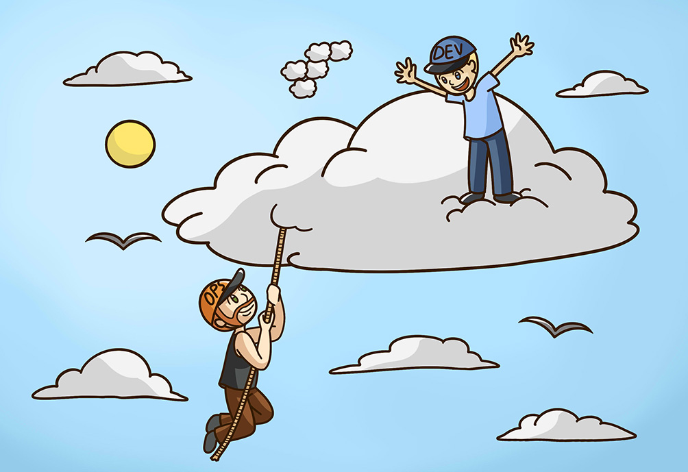
Section break slide
_cloud

Slide 3
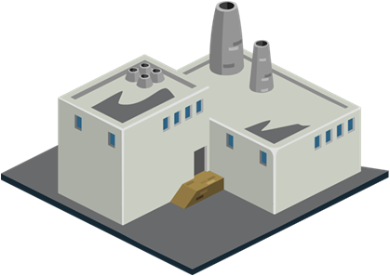
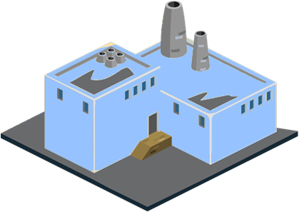


Section content slide
_cloud “…just someone else computer”
80%
20%
0,1%

Slide 4
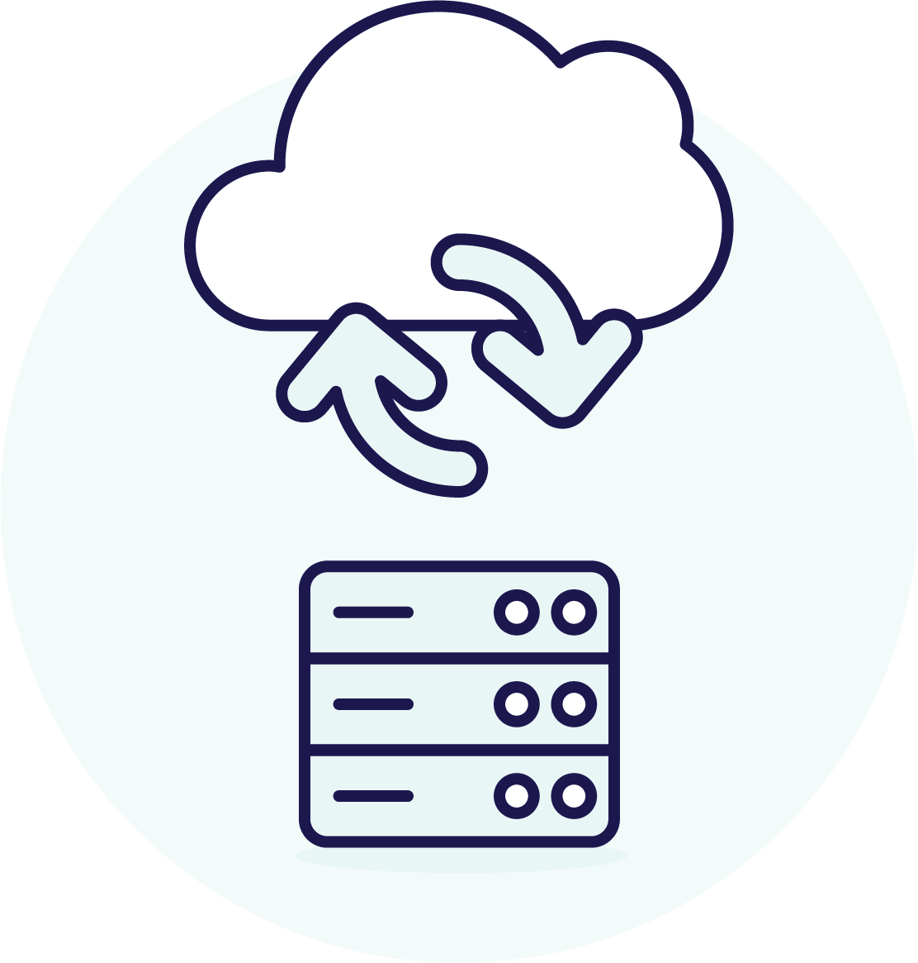
Content slide
Multi-Cloud
Cloud
Public Cloud
_cloud models
“Hybrid Cloud”
Hybrid Cloud
On-Premise
Public Cloud
Private Cloud
Multi-Cloud
Hybrid Cloud
Private Cloud
On-Premise

Slide 5
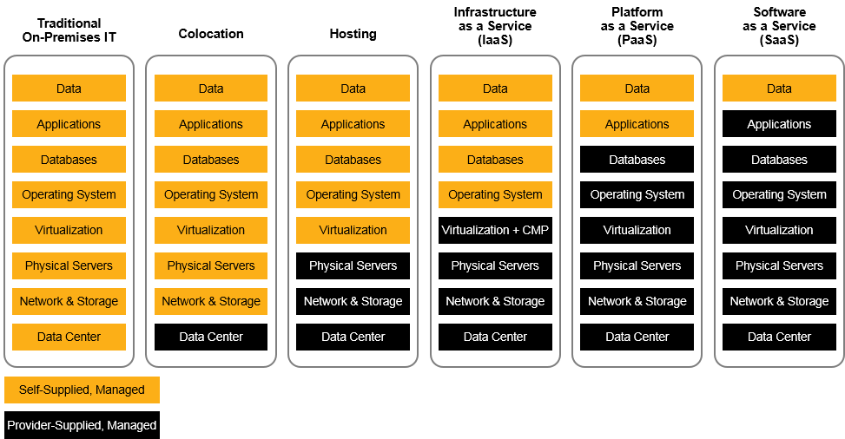
Section content slide
_cloud Service Models
You take care of the heavy lifting
Cloud vendor does most of the job

Slide 6
Content slide
_cloud
Speed and agility
Cost
Service portfolio
Scalable
Global reach
Security
Cloud computing is the on-demand delivery of compute power, database, storage, applications, and other IT resources through a cloud services platform via the Internet with pay-as-you-go pricing.
Notes:
The formal cloud computing definition from ISO/IEC 17788:20143 is as follows:
“Cloud computing: Paradigm for enabling network access to a scalable and elastic pool of shareable physical or virtual resources (examples of resources include servers, operating systems, networks, software, applications, and storage equipment) with self-service provisioning and administration on-demand.”
https://download.microsoft.com/download/0/D/6/0D68AE95-6414-4074-B4B8-34039831E2BF/Introduction-to-Cloud-Computing-for-Legal-and-Compliance-Professionals.pdf
Speed and Agility
Cloud Services reachable via APIs
Cloud Services reachable by Everyone
Experiment is cheap
Stick to software delivery fundamentals
Pay for what you use
No upfront investment (CAPEX → OPEX)
Free plan to get started
Service portfolio
Security
Global reach
Scalable

Slide 7
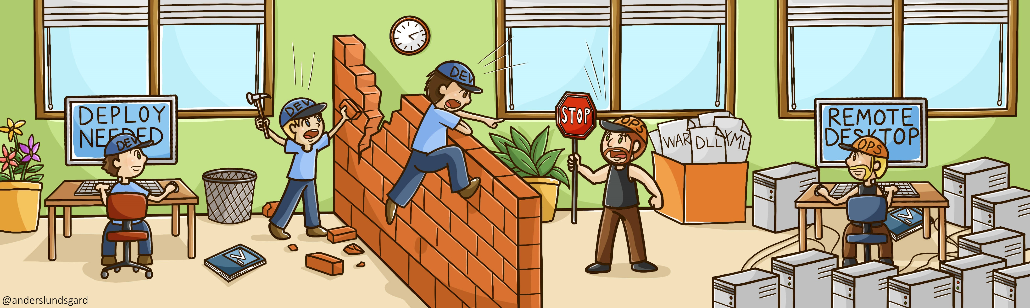
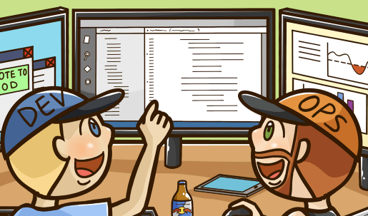




Section content slide
_speed and agility
Deliver our servers!
Let’s auto-scale your servers
API CreateServer
Cloud Services reachable via APIs
Experiment is cheap
Instead of calling or email an order of a server, you simply call an API and the server starts to provision
Do short experiments with different cloud services to evaluate what fits you the best
Cloud Services reachable by Everyone
Stick to software delivery fundamentals
Startups and large enterprises have the same ability to utilize all available cloud services
Cloud platforms adhere to proven software engineering practices:
Versioning (Infrastructure as Code)
Automation (CI/CD)

Slide 8
Section content slide
_cost
Per second billing
You are only billed for the time servers and other services are running
Blurred by purpose ☺

Slide 9
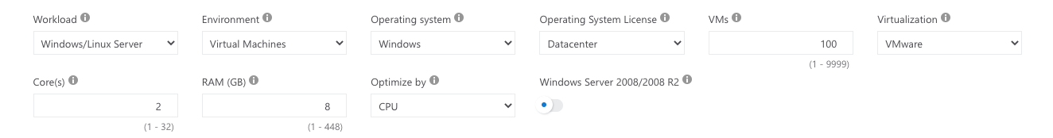
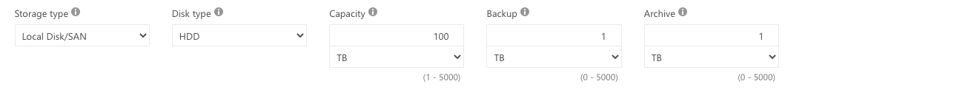
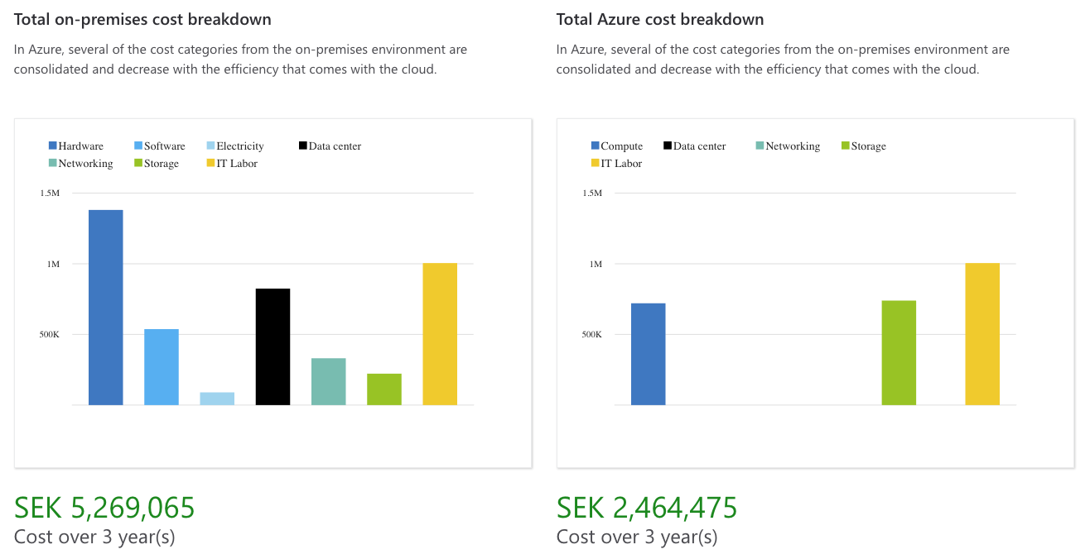
Section content slide
https://azure.microsoft.com/en-us/pricing/tco/calculator/
Lift and shift
50%
savings
Notes:
https://azure.microsoft.com/en-us/pricing/tco/calculator/

Slide 10
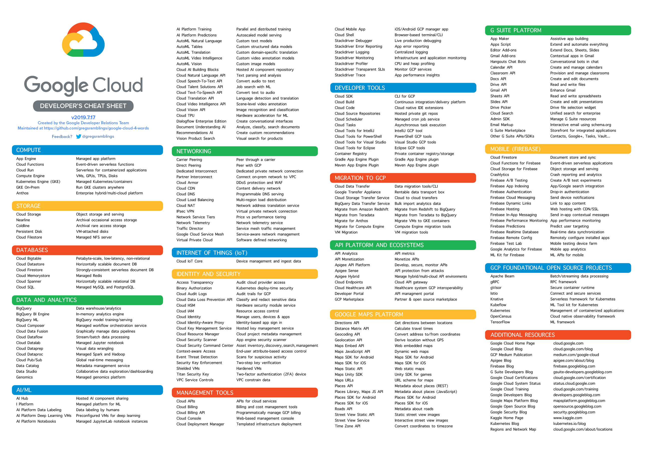
Section content slide
_service portfolio
Cost savings

Slide 11
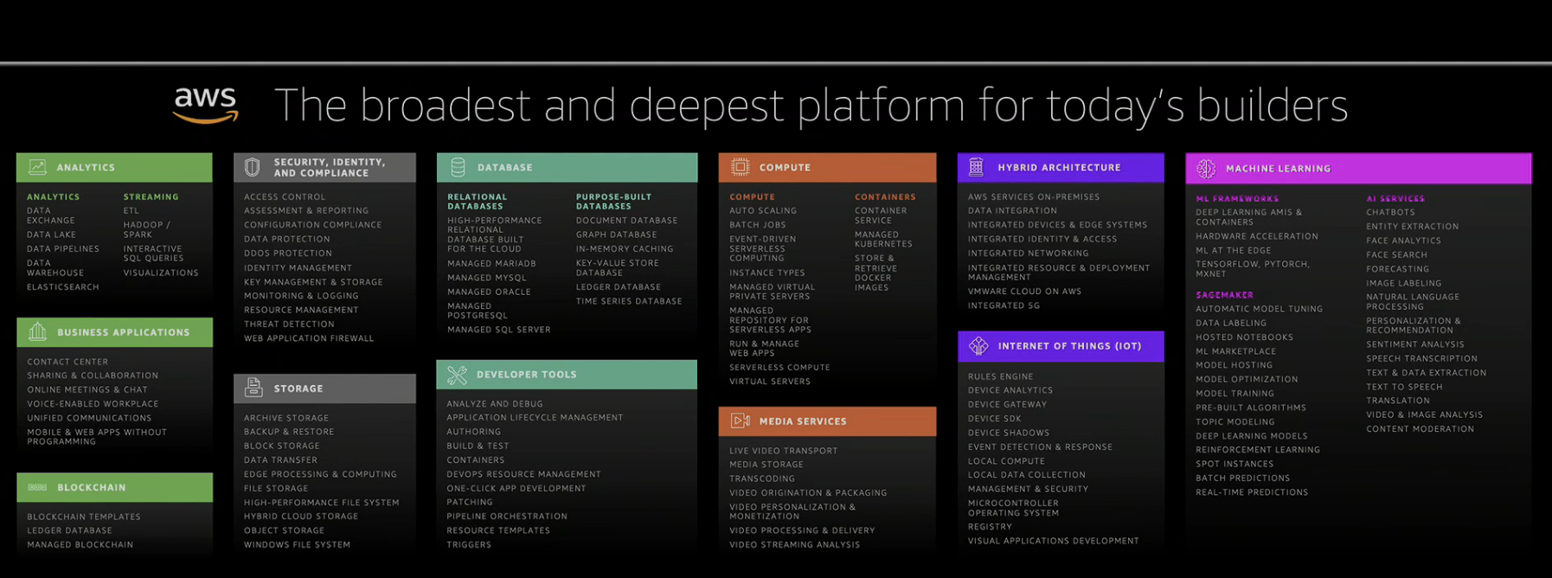
Section content slide
_service portfolio
Cost savings

Slide 12

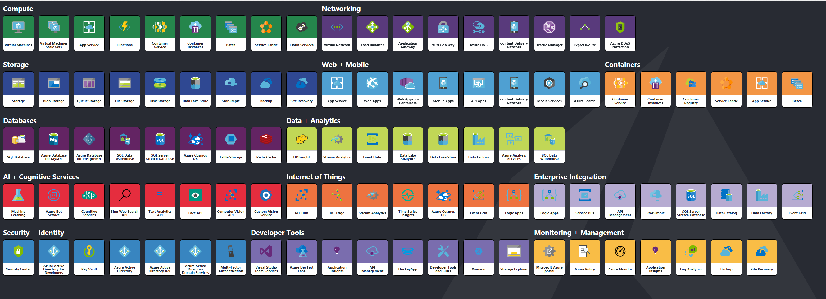
Section content slide
_service portfolio
Cost savings

Slide 13
Section content slide
_scalable
Scale up when needed…
7
6
5
4
3
2
1
0
Capacity planning goes away
Cost savings
As a customer of the big cloud vendors, you experience unlimited amount of capacity
…and down when demand is low

Slide 14
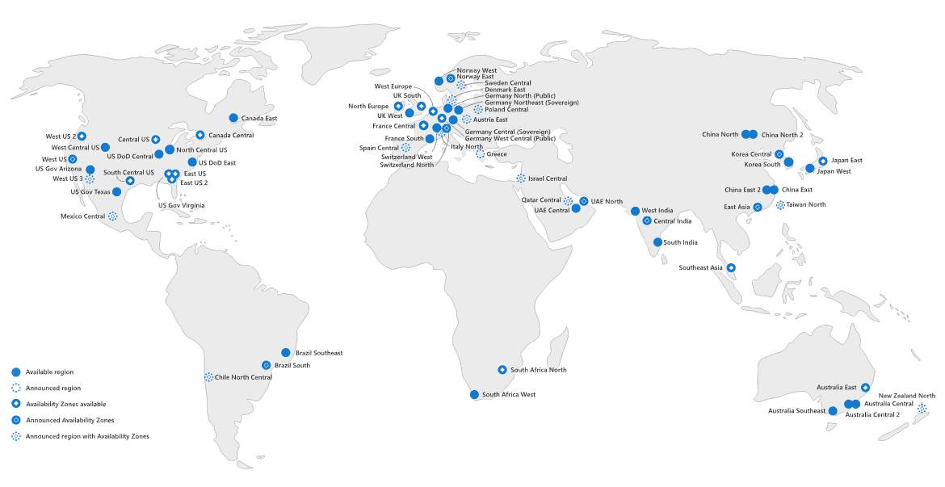
Section content slide
_global reach

Slide 15
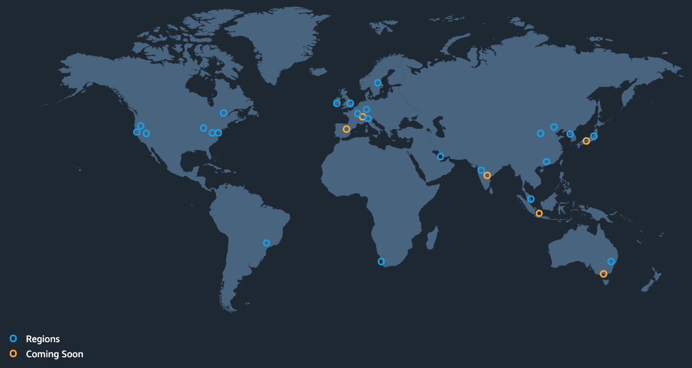

Section content slide
_global reach

Slide 16


Section content slide
_global reach
Region Stockholm
Västerås
Eskilstuna
Katrineholm

Slide 17





Section content slide
_security
Do you trust the chosen cloud vendor(s)?
If security is important to you and you believe you have better security mechanisms than the cloud vendor. Do not go public cloud at least.
Are there any regulatory constraints?
Company or country regulations limit you to chosen provider or geographic location.
Do you dare to invest time to learn cloud security?
Within the shared responsibility model for cloud providers, they state that you as a customer need to understand and utilize the security mechanisms that the vendor provides.
Cloud is the safest place for your data!
Notes:
Large cloud vendors address regulatory compliance needs every day and because these vendors are dealing with large volumes of customers and data that span virtually every industry and every country, their broad experience in standards and regulatory compliance is more complete than any one company can have on its own.

Slide 18
Section content slide
_remove undifferentiated heavy lifting
Blurred by purpose ☺

Slide 19
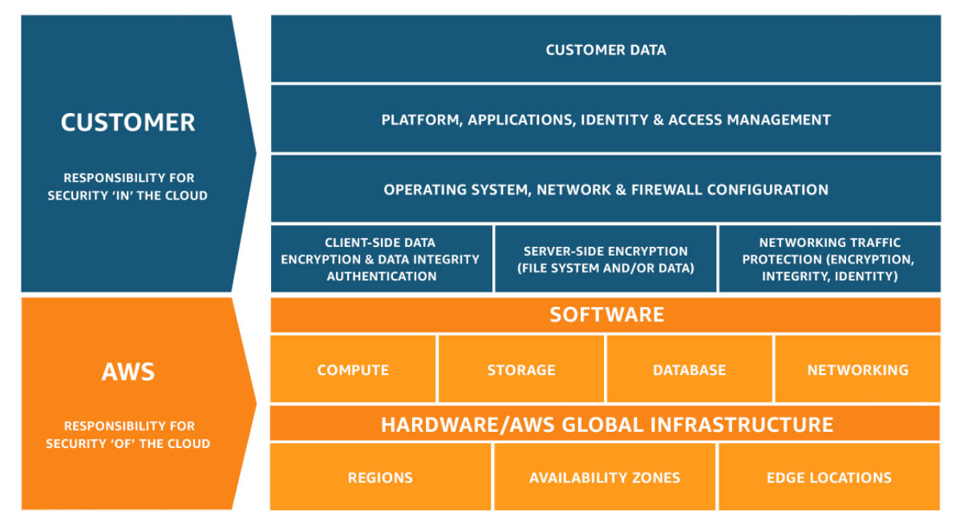
Content slide
_shared responsibility model
Security and Compliance is a shared responsibility between cloud vendor and the customer.

Slide 20



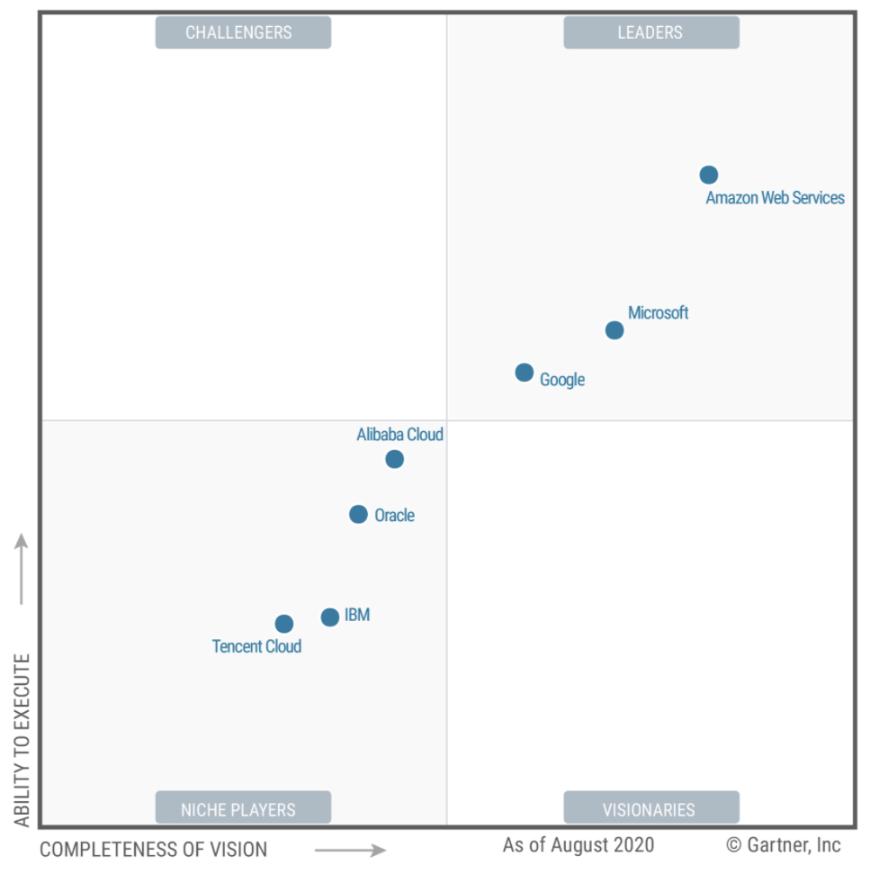
Image mask slide
_largest cloud vendors
Gartner Report - 2020 Magic Quadrant for Cloud Infrastructure & Platform Services

Slide 21

Content slide
Cloud Adoption Framework
Cloud Strategy (Vendor(s), Hybrid?, Cloud Native?)
_cloud Journey
Cloud Center of Excellence (CCoE)
Shared Responsibility Model
When large companies start to adopt cloud, they often pass some common milestones.
Well Architected Framework
Migrate workloads to cloud

Slide 22

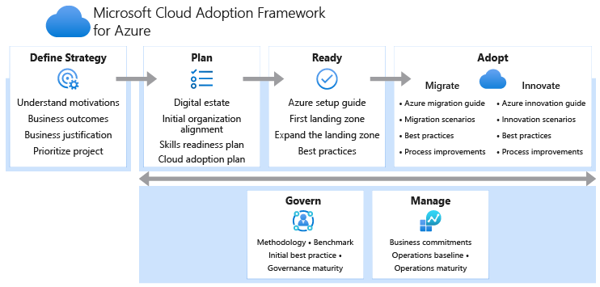
Content slide
_cloud Adoption Framework
Well Architected workshops is a common way to initiate a relation with new clients.

Slide 23
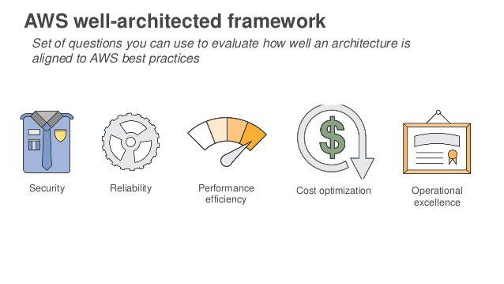
Content slide
_cloud Well Architected Framework
Well Architected workshops can be used to initiate a relation with new (or build trust to existing) clients.

Slide 24


Content slide
Cloud
Monolith
_cloud Migration
Re-host / “Lift and shift”
Re-platform
Re-architect / Re-factor
Re-purchase
Retire
Retain
Monolith
On-Premise

Slide 25

Content slide
Cloud
Microservices
_cloud Migration
Re-host / “Lift and shift”
Re-platform
Re-architect / Re-factor
Re-purchases
Retire
Retain
Monolith
On-Premise

Slide 26
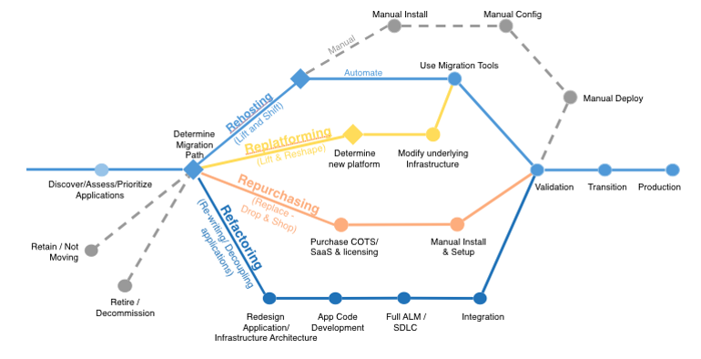
Content slide
_cloud Migration
Re-host / “Lift and shift”
Re-platform
Re-architect / Re-factor
Re-purchases
Retire
Retain
AWS Migration Whitepaper

Slide 27







Content slide
Avoid Shadow IT
Align the purpose and add cloud to your IT strategy
Invest in cloud education
_cloud challenges
Define a shared responsibility model within your company
Migration to cloud is complex. It involves a lot new technologies but most important – it affects so many of current employees and the way they do IT today.
Find your migration pace and prioritize among projects
Do not forget On-Premise!
Deal with the impact of the new technology
Notes:
The formal cloud computing definition from ISO/IEC 17788:20143 is as follows:
“Cloud computing: Paradigm for enabling network access to a scalable and elastic pool of shareable physical or virtual resources (examples of resources include servers, operating systems, networks, software, applications, and storage equipment) with self-service provisioning and administration on-demand.”
https://download.microsoft.com/download/0/D/6/0D68AE95-6414-4074-B4B8-34039831E2BF/Introduction-to-Cloud-Computing-for-Legal-and-Compliance-Professionals.pdf
Speed and Agility
Cloud Services reachable via APIs
Cloud Services reachable by Everyone
Experiment is cheap
Stick to software delivery fundamentals
Pay for what you use
No upfront investment (CAPEX → OPEX)
Free plan to get started
Service portfolio
Security
Global reach
Scalable

Slide 28
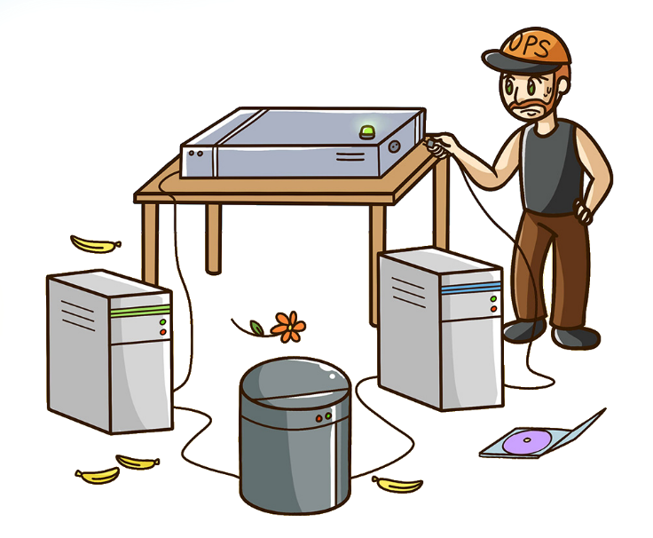
Section content slide
_infrastructure as code
Resources:
ElasticLoadBalancer:
Type: AWS::ElasticLoadBalancing::LoadBalancer
Properties:
SecurityGroups:
- !Ref LoadBalancerSecurityGroup
Subnets:
- !ImportValue: PublicSubnet1A
- !ImportValue: PublicSubnet1B
Listeners:
LoadBalancerPort: 443
InstancePort: 8080
Protocol: HTTPS
SSLCertificateId: !ImportValue CertificateId
HealthCheck:
Target: 'HTTP:80/'
HealtyThreshold: 2
UnhealtyThreshold: 3
Interval: 20
Timeout: 10

Slide 29
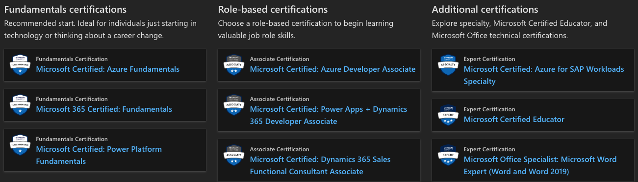

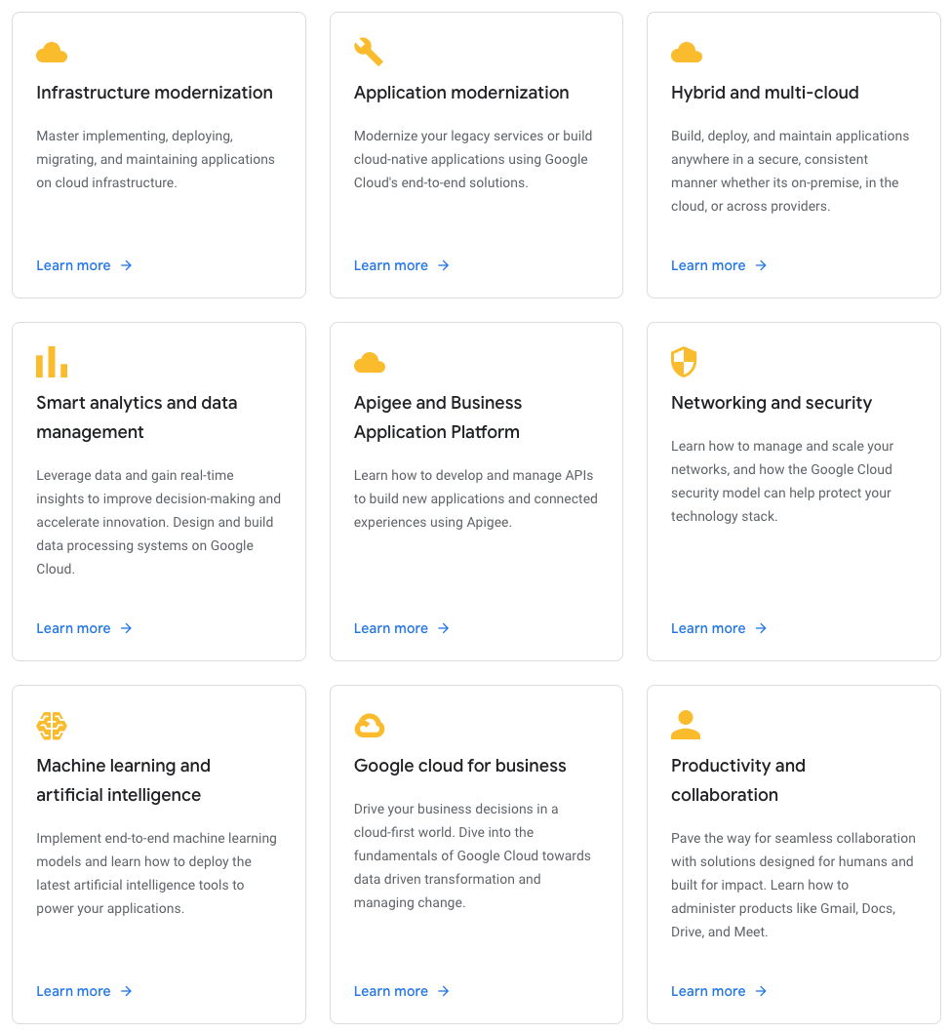
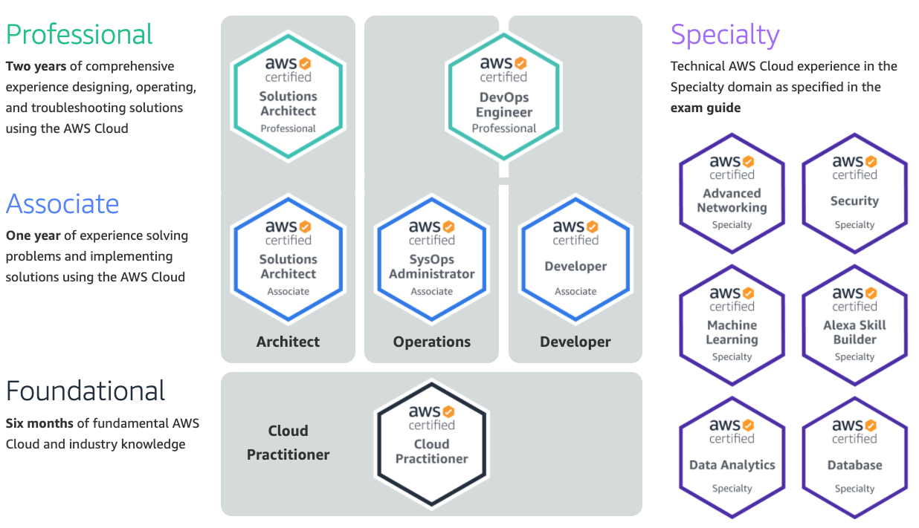
Content slide
_cloud certification
Certifications are not only for engineers!
Mixed opinions about the actual value of certifications
Notes:
Getting started with AWS post by Matthias on Happeo:
https://app.happeo.com/channels/61931524/Inspiration/discussion/77197946

Slide 30
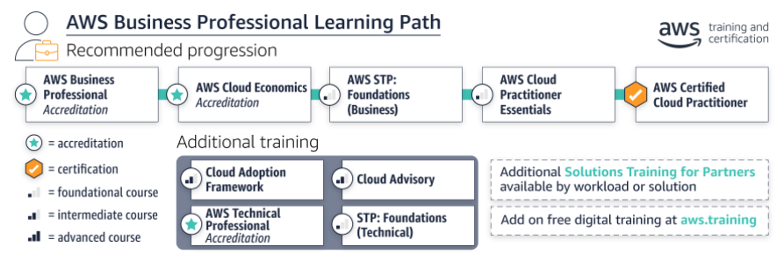
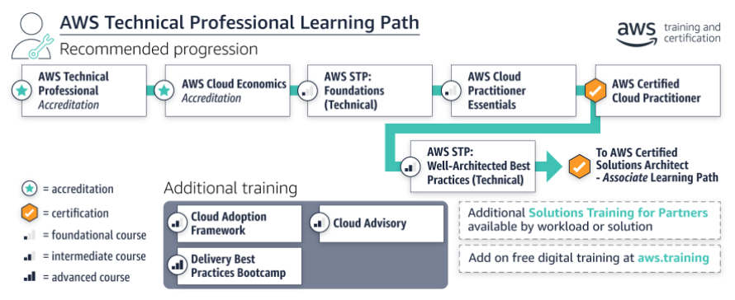
Content slide
Total: 18h digital on-demand training
_cloud certification
Mixed opinions about the actual value of certifications
Certifications are not only for engineers!
Notes:
Getting started with AWS post by Matthias on Happeo:
https://app.happeo.com/channels/61931524/Inspiration/discussion/77197946

Slide 31
Ending strong slide

Slide 32
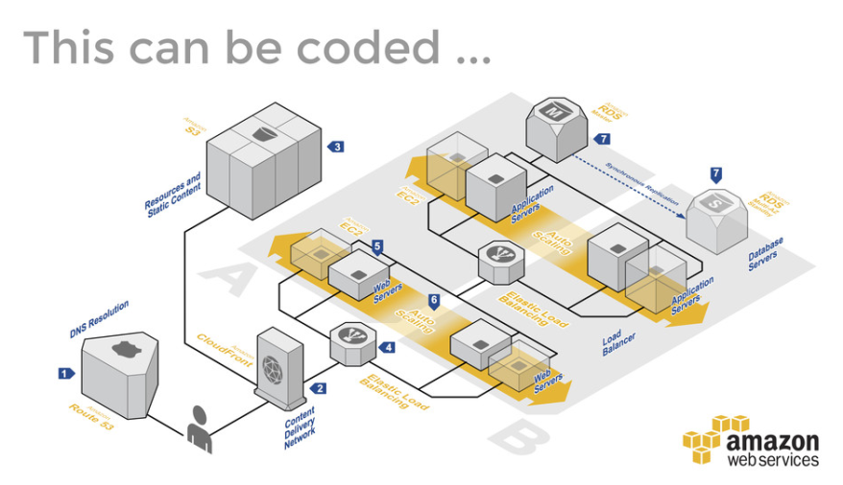

Slide 33

Ninja presentation slide
_Anders Lundsgård
_todos
Version Control
Compute models
Virtual machines
Containers
Serverless

